Slide 1
Regional Planning – Norfolk
Norfolk Public Library
308 Prospect Ave
Norfolk, Nebraska 68701
August 10, 2017
1:30pm – 4:30pm CT

Slide 2
Welcome
Becky Maggart
NDOL Norfolk Office Manager

Slide 3
Regional Planning Process
1:30 – Welcome & Overview
1:40 – Labor Market Information
2:00 – Vision for Columbus Region
2:30 - Roles
3:00 – Break
3:15 – Regional Strategies
4:15 – Continued Engagement
The Greater Nebraska Workforce Development Board will provide coffee and light snacks.

Slide 4
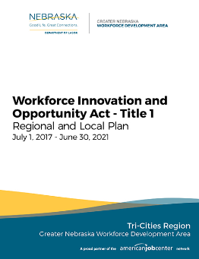
Required Regional Plans
The Greater Nebraska Workforce Development Board has prepared a Tri-Cities Regional plan, Scottsbluff Regional plan, and local workforce development plan for the period July 1, 2017 through June 30, 2021. The board will be preparing regional plans for North Platte, Norfolk, and Columbus this year. This plan covers Madison, Antelope, Pierce, Stanton, and Wayne counties designated by the Governor. The Norfolk Regional Plan will meet the requirements of the Workforce Innovation and Opportunity Act (WIOA) by establishing local and regional strategies for directing investments in economic, education and workforce training programs with the end results being individuals acquiring skills to compete in the job market and employers having a ready supply of skilled workers.
Plans are posted at dol.nebraska.gov

Slide 5
Purpose
The purpose of the planning session is to identify and align workforce development activities and resources with larger regional economic development areas and available resources to provide coordinated and efficient services to both job seekers and employers.

Slide 6
Regional Plan Chapters
Chapter 1. Economic and Workforce Analysis
Chapter 2. Vision and Goals
Preparing an educated and skilled workforce, including youth and individuals with barriers to employment
Chapter 3. Workforce System – Integration of Strategies and Services
Sector Initiatives
Cooperation, Collaboration, & Coordination
Services in Rural Areas
Career Pathways
Business Needs
Economic Development
Training Initiatives

Slide 7
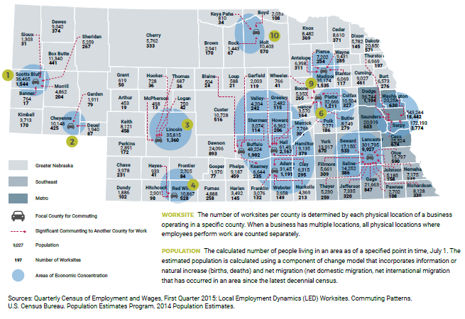
Counties in Norfolk Region
Notes:
Madison, Antelope, Pierce, Stanton, and Wayne

Slide 9
Introductions
Regional workforce system partners and how they currently fit into the system

Slide 10
Worksites and Population
Table 1: Norfolk Region

Slide 11
Industry and Wages
Table 2: Labor Market Information – Fourth quarter of 2016 Quarterly Census of Employment and Wages, Multiple Industries data for Norfolk Micropolitan Statistical Area
Industry | Establishments | Employment | Total Wage | Average Weekly Wage
Total, All Industries | 1,941 | 25,091 | $258,855,204 | $794
Accommodation and Food Services | 107 | 1,696 | $5,728,343 | $260
Administrative and Waste Services | 69 | 801 | $6,917,640 | $664
Agriculture, Forestry, Fishing & Hunting | 51 | 348 | $3,583,572 | $792
Arts, Entertainment, and Recreation | 17 | 125 | $453,753 | $279
Construction | 197 | 1,191 | $15,999,282 | $1,033
Educational Services | 32 | 2,211 | $21,000,046 | $731
Finance and Insurance | 125 | 868 | $11,623,351 | $1,030
Health Care and Social Assistance | 424 | 4,760 | $49,734,786 | $804
Information | 24 | 278 | $2,665,538 | $738
Management of Companies and Enterprises | 9 | 35 | $1,182,253 | $2,598
Manufacturing | 64 | 3,774 | $52,863,528 | $1,077
Mining, Quarrying, and Oil and Gas Extraction | 6 | Confidential | Confidential | Confidential
Other Services, Ex. Public Admin | 127 | 743 | $4,742,418 | $491
Professional and Technical Services | 97 | 687 | $7,954,172 | $891
Public Administration | 56 | 1,097 | $11,285,702 | $791
Real Estate and Rental and Leasing | 54 | 234 | $1,904,981 | $626
Retail Trade | 246 | 3,418 | $21,728,313 | $489
Transportation and Warehousing | 126 | 974 | $11,061,066 | $874
Utilities | 8 | Confidential | Confidential | Confidential
Wholesale Trade | 102 | 1,617 | $24,602,070 | $1,170
Notes:
The top five industries , by employment, for the Scottsbluff Micropolitan Statistical Area are: Health Care and Social Assistance at 3,405, Retail Trade at 2,404, Accommodations and Food Services at 1,537, Education Services at 1,462, and Construction at 1,257 as noted in table 2.

Slide 12
High Wage, High Skill, High Demand (H3)
Table 4: Labor Market Information - Long-term Occupational Projections, 2014-2024 with High Wage, Skill, and Demand (H3) Indicators - Northeast Economic Region
SOC Title | 2014 Estimated Employment | 2024 Projected Employment | Growth Openings | Percent Change
Heavy and Tractor-Trailer Truck Drivers | 3,870 | 4,315 | 445 | 11.5%
Industrial Machinery Mechanics | 860 | 1,105 | 245 | 28.5%
Registered Nurses | 2,142 | 2,304 | 162 | 7.6%
Maintenance and Repair Workers, General | 1,483 | 1,584 | 101 | 6.8%
Welders, Cutters, Solderers, and Brazers | 915 | 1,009 | 94 | 10.3%
General and Operations Managers | 1,040 | 1,129 | 89 | 8.6%
Licensed Practical and Licensed Vocational Nurses | 851 | 940 | 89 | 10.5%
Elementary School Teachers, Except Special Education | 1,145 | 1,230 | 85 | 7.4%
Machinists | 467 | 563 | 96 | 20.6%
Accountants and Auditors | 662 | 750 | 88 | 13.3%
Notes:
The Nebraska Departments of Labor and Education, in partnership with the Nebraska Department of Economic Development, have focused their respective efforts towards existing and emerging occupations that meet certain high wage, high skill and high demand criteria. Known as H3 occupations, these occupations are considered high wage when at least half of their wage measures are at or above the regional average for all occupations. Occupations that require either some college or a higher level of educational attainment are high skill; these include occupations that require a high school diploma or equivalent plus long-term on-the-job training, an apprenticeship, or an internship or residency. The number of annual openings, net change in employment, and growth rate determine whether an occupation is in high demand.
As shown in Table 4, the top H3 occupations in terms of the projected number of job growth includes registered nurses; general and operations managers; accountants and auditors; heating, air conditioning; and refrigeration mechanics and installers; maintenance and repair workers; carpenters; electrical power-line installers and repairers; bus and truck mechanics and diesel engine specialists; licensed practical and licensed vocational nurses; and industrial machinery mechanics.
These occupations are projected to experience growth ranging from 3% to 12%. Subsequently, these professions offer an attractive wage and provide jobseekers with a range of rewarding career options within the region.

Slide 13
Unemployment
As of June 2017, the unemployment rate for the Norfolk Micropolitan Area, is 2.9%, dangerously close to full employment. A total of 771 individuals are unemployed while at the same time, there are 1,387 available jobs to be filled.
Notes:
Columbus is 3.1%

Slide 14
Vision for Norfolk
Greater Nebraska’s Vision
To deliver local coordinated, proactive, responsive and adaptable services for jobseekers and employers to maximize opportunities for earning, learning, and living.

Slide 15
Goal 1
The Norfolk Region will enhance coordination between plan partners and other key stakeholders at all stages of the workforce development spectrum to ensure jobseekers and businesses are provided highly coordinated and seamless services, reducing duplication of effort, better understanding the needs of employers and workers, and maximizing the resources available to the State’s workforce partners.

Slide 16
Goal 2
The Norfolk Region will increase workforce participation by expanding access, support and service to assessment, education, training, employment services and other forms of assistance that prepare Veterans, low-income individuals, English Language Learners, single parents, farmworkers, in-school and out-of-school youth, the unemployed and other disadvantaged populations for rewarding careers within the state.

Slide 17
Goal 3
The Norfolk Region will enhance employer engagement between secondary and post-secondary education institutions and training programs to better meet employers’ workforce needs through industry-driven strategies. These strategies will incorporate the proactive use of available workforce and industry data to help determine future industry needs, potential workforce disruptions, and to ensure the availability of a skilled workforce to drive growth within the state’s high-wage, high-skill and high-demand industries and occupations.

Slide 18
Goal 4
The Norfolk Region will promote self-sufficiency among Nebraska’s disadvantaged populations by eliminating barriers to employment and providing coordinated services that lead to family-sustaining employment.

Slide 19
Integration of Strategies
How can we improve the system and build upon the goals identified by the board?
List five action steps.
Greater Nebraska’s Vision
To deliver local coordinated, proactive, responsive and adaptable services for jobseekers and employers to maximize opportunities for earning, learning, and living.

Slide 20
Sector Initiatives
Manufacturing?
Greater Nebraska’s Vision
To deliver local coordinated, proactive, responsive and adaptable services for jobseekers and employers to maximize opportunities for earning, learning, and living.

Slide 21
Training Initiatives
?
Greater Nebraska’s Vision
To deliver local coordinated, proactive, responsive and adaptable services for jobseekers and employers to maximize opportunities for earning, learning, and living.

Slide 22
System Partners
Partner Program
Adult, & DLW WIOA Programs
Youth WIOA Program
Jobs for Veterans' State Grants
Wagner-Peyser Employment Services
Trade Adjustment Assistance
Unemployment Insurance
Adult Education & Adult Secondary Education
Vocational Rehabilitation
Commission for the Blind & Visually Impaired
Senior Community Service Employment Program
Temporary Assistance for Needy Families
Job Corps
Migrant and Seasonal Farmworker Programs
Native American Programs
Career and Technical Education Programs at the Postsecondary Level
Employment and Training Activities Carried Out Under the Community Services Block Grant
Second Change Act (ex-offender) programs
Supplemental Nutrition Assistance Program
Employment and training activities carried out by the Department of Housing and Urban Development
Reentry Employment Opportunities

Slide 23
Continued Engagement
Moving Forward
Join the Executive Committee and public to review the Columbus and Norfolk Regional Plans.
City of Madison – Town Hall
211 S Lincoln Street
Madison, NE 68748
September 14, 2017
10:30 am – 12:00 pm CT
Greater Nebraska’s Vision
To deliver local coordinated, proactive, responsive and adaptable services for jobseekers and employers to maximize opportunities for earning, learning, and living.

