Slide 1
GEATER NEBRASKA WORKFORCE DEVELOPMENT BOARD
ORIENTATION MANUAL
Notes:
The formatting of this PowerPoint was taken from the State WIB Orientation. Orange slides have been updated to reflect the Greater Nebraska Workforce Development Board information. Green slides have yet to be updated.

Slide 2
background on the
WORKFORCE INNOVATION AND OPPORTUNITYACT (WIOA)

Slide 3
WIOA Vision Statement:
The Workforce Innovation and Opportunity Act (WIOA) was created to provide state and local areas the flexibility to collaborate across systems in an effort to better address the employment and skill needs of current employees, jobseekers, and employers. WIOA accomplishes this by prescribing:
1. A stronger alignment of the workforce, education, and economic development systems; and
2. Improving the structure and delivery in the system to assist America’s workers in achieving a family-sustaining wage while providing America’s employers with the skilled workers they need to compete on a global level.

Slide 4
Mission and Vision of the Local Board :
TBD by the GNWDB Board

Slide 5
Who Serves on the Local Board?
A Business Majority
20% Representatives of workforce within the state including representatives of labor organizations
Education and Training Representatives
Government and Economic/Community Development entities

Slide 6
GNWDB MEMBERS
BUSINESS REPRESENTATIVES
AGRICULTURAL MACHINERY
Wayne Brozek, 21st Century Equipment - Scottsbluff
Stacey Weaver, Chief Agri-Industrial - Kearney
Lisa Wilson, Case New Holland – Grand Island
BUSINESS MANAGEMENT & MANUFACTURING
Peggy Sandall-Bertrand, Advance Services, Inc - Columbus
FOOD PROCESSING/MANUFACTURING
Michelle Engel, Westin Packaged Meats - Fairbury
HEALTH SERVICES
Charlene Lant, St. Mary’s Hospital – Nebraska City

Slide 7
BUSINESS REPRESENTATIVES (CONTINUED)
HEALTHCARE MANUFACTURING
Jill Smith, BD Diagnostics, Preanalytical Solutions – Broken Bow
PRECISION METALS MANUFACTURING
Denise Pfeifer, Hamilton Sundstrand – York
RENEWABLE ENERGY
Greta Kickland, Cameco Crow Butte Resources – Crawford
TRANSPORTATION, WAREHOUSING, & DISTRIBUTION LOGISTICS
Cory Goehring, Bosselman Companies – Grand Island

Slide 8
WORKFORCE REPRESENTATIVES
APPRENTICESHIP PROGRAM
Chris Callihan, IBEW Local 265 – Lincoln (Oversees all of Greater Nebraska)
LABOR ORGANIZATION
Gary Kelly, IBEW Local 22 – Omaha (Oversees all of Greater Nebraska)
Roy Lamb, IBEW Local 265 – Lincoln (Oversees all of Greater Nebraska)
YOUTH ORGANIZATION
Vacant, Indian Center Inc. – Lincoln (Oversees all of Greater Nebraska)
EDUCATION REPRESENTATIVES
ADULT EDUCATION & LITERACY
Ann Chambers, Central Community College – Grand Island
HIGHER EDUCATION
Karen Severson, Northeast Community College – Norfolk

Slide 9
GOVERNMENT, ECONOMIC, AND COMMUNITY DEVELOPMENT
COMMUNITY DEVELOPMENT
Dan Mauk, North Platte Chamber of Commerce – North Platte
VOCATIONAL REHABILITATION
Elaine Anderson, Nebraska Department of Vocational Rehabilitation – Kearney
WAGNER-PEYSER
Kelsey Miller, Nebraska Department of Labor – North Platte

Slide 10
Governor Pete Ricketts
Nebraska Workforce Development Board (NWDB)
Greater Nebraska Chief Elected Officials Board (CEOB)
Pamela Lancaster, Chair
Greater Nebraska Workforce Development Board (GNWDB)
Lisa Wilson, Chair
Standing Committees
(To be Determined)
Board Support & Administrative Entity
Nebraska Department of Labor
BOARD STRUCTURE

Slide 11
Standing Committees (TBD)
WIOA requires local boards to take on several program oversight functions. Since a local board may or may not have the time and capacity to handle all issues themselves, there is a need to create specialized committees made up of board members to handle some of these oversight responsibilities.
Board Responsibilities include:
Local Plan Development
Workforce Research and Regional Labor Market Analysis
Convening, Brokering, Leveraging- with local workforce development system stakeholders
Employer Engagement
Career Pathways Development
Proven and Promising Practices
Technology
Program Oversight
Negotiation of Local Performance Accountability Measures
Designation and/or Certification of One-Stop Operators
Coordination With Educational Providers
Notes:
This information is based off of the current GNWIB Bylaws and may change once the GNWDB bylaws are created and approved.

Slide 12
P.L 113-128, July 2014
WORKFORCE INNOVATION AND OPPORTUNITY ACT

Slide 13
WIOA Legislative Reforms
Streamline and Strengthen the Strategic Roles of Workforce Development Boards: WIOA makes state and local boards more agile and well-positioned to meet local and regional employers’ workforce needs.
Improve Services to Employers and Promotes Work-based Training: WIOA contributes to economic growth and business expansion by ensuring the workforce system is job-driven, matching employers with skilled individuals.
Provide Access to High-quality Training: WIOA helps jobseekers acquire industry-recognized credentials for in-demand jobs.
Require States to Strategically Align Workforce Development Programs: WIOA ensures that employment and training services provided by the core programs are coordinated and complementary so that jobseekers acquires skills and credentials that meet employers’ needs.
Foster Regional Collaboration: WIOA promotes alignment of workforce development programs with regional economic development strategies to meet the needs of local and regional employers.

Slide 14
WIOA Legislative Reforms (continued)
Promote Accountability and Transparency: WIOA ensures that Federal investments in employment and training programs are evidence-based and data-driven and accountable to participants and taxpayers.
Improve the American Job Center (AJC) System: WIOA increases the quality and accessibility of services that jobseekers and employers receive at their local AJCs.
Make Key Investments in Serving Disconnected Youth and Other Vulnerable Populations: WIOA prepares vulnerable youth and other job seekers for successful employment through increasing the use of proven service models.
Improve Services to Individuals with Disabilities: WIOA increases access for individuals with disabilities’ to high quality workforce services and prepares them for competitive integrated employment.
Enhance Workforce Services for the Unemployed and other Job Seekers: WIOA ensures that unemployed and other jobseekers have access to high-quality workforce services.

Slide 15
The One-Stop Delivery System...
In general, the One-Stop delivery system is a system under which entities responsible for administering separate workforce investment, educational, and other human resource programs and funding streams (referred to as One-Stop partners) collaborate to create a seamless system of services and improve long-term employment outcomes for individuals receiving assistance.
Title I of WIA assigns responsibilities at the local, State and Federal level to ensure the creation and maintenance of a One-Stop delivery system that enhances the range and quality of workforce development services that are accessible to individuals seeking assistance.
The system must include at least one comprehensive physical center in each local area, which includes all required one-stop partners.

Slide 16
The One-Stop Delivery System...
While each local area must have at least one comprehensive center (and may have additional comprehensive centers), WIA section 134(c) allows for arrangements may include:
A network of affiliated sites that can provide one or more partners’ programs, services and activities at each site.
A network of One-Stop partners through which each partner provides services that are linked, physically or technologically, to an affiliated site that assures individuals are provided information on the availability of core services in the local area; and
Specialized centers that address specific needs, such as those of dislocated workers.
The design of the local area’s One-Stop delivery system, including the number of comprehensive centers and the supplementary arrangements, must be described in the local plan and be consistent with the Memorandum of
Understanding executed with the One-Stop Partners.

Slide 17
NEBRASKA WIOA SYSTEM
Nebraska Department of Labor (NDOL)
Greater Nebraska
Governor
Chief Elected Officials Board (CEOB)
Greater Omaha
Mayor of Omaha
Accepts funds for Nebraska
from US Department of Labor
State Workforce Development Board
“The State”
Nebraska Workforce Development Board
Governor
Greater Lincoln
Mayor of Lincoln
City of Lincoln
City of Lincoln
NDOL
NDOL
Heartland Workforce Solutions
Goodwill Industries
Local Areas
Grant Subrecipients
Local Workforce Development Boards
Service Provider
Greater Lincoln Workforce Development Board
Local Workforce Development Board
Local Workforce Development Board
Local Workforce Development Board Support

Slide 18
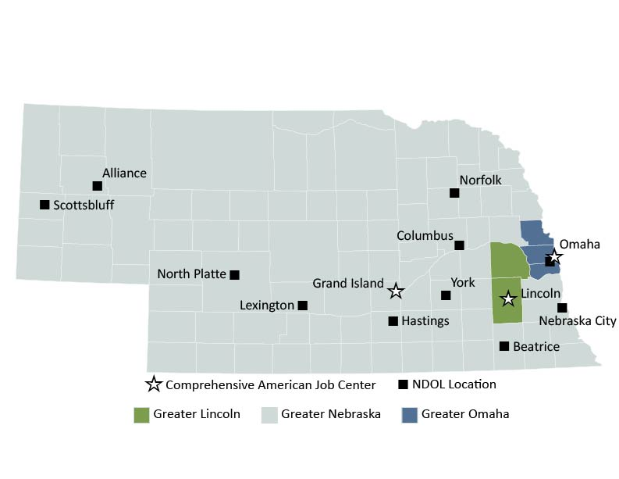
NEBRASKA WIOA SYSTEM

Slide 19
WIOA FUNDING DISTRIBUTION PY15
WIOA Title I Adult, Youth, and Dislocated Worker Funding = $6,373,045
Youth = $2,425,096
Adult = $1,931,641
Dislocated Worker = $2,016,308
Notes:
Allocation amounts are based on WIA amounts.

Slide 20
Performance
Change from 9 measures under WIA to 15 plus additional employer measures under WIOA.
Will take effect beginning July 1, 2016
 | WIA | WIOA
Adult | Entered Employment Rate | Employment Rate (2nd quarter after exit)
 | Employment Retention Rate | Employment Retention Rate Employment Rate (4th quarter after exit)
 | Average Earnings | Median Earnings (2nd quarter after exit)
 |  | Credential Rate (within 1 year after exit)
 |  | Measurable Skills Gain (real time measure)

Slide 21
AVAILABLE EMPLOYER SERVICES
Nebraska Employers will find convenient services and a rich source of information in the Employer Services portion of the Nebraska Department of Labor site. Whether you are searching for good employees (and who isn’t!), looking for a convenient, hassle free way to meet your Unemployment Insurance obligations, or seeking information about Nebraska’s economy and labor market, you will find it here.
NEworks.nebraska.gov: Nebraska’s largest on-line labor exchange. You can post job openings, search resumes, track applicants, access hundreds of employer resources, and at no cost to the employer!
Worker Training: Nebraska’s worker training program makes funds available to you to train or retrain your current workforce.
Safety/Labor Laws: Nebraska’s Safety and Labor Laws provide rights and protection to workers and create certain obligations for employers.

Slide 22
Labor Market Information: Learn about the local economy and what’s new in your labor market. Find out what the market rate is for the jobs you are trying to fill. Labor Market Information can provide a competitive edge; access it at NEworks.nebraska.gov
Unemployment Insurance: Everything you need to know about your rights and obligations regarding Unemployment Insurance taxes. Check out “UIConnect”, Nebraska’s nationally recognized, secure internet site for filling your Unemployment Insurance taxes.
Foreign Labor Certification: Prior to bring foreign workers into the U.S, employers must file a labor certification application. This area provides required forms and complete information.
Dislocated Workers: If your company is forced to undergo a worker dislocation, you may have certain obligations under Federal Law.
Rapid Response: If your company is laying off employees, Rapid Response informs those employees about the Unemployment Insurance, training programs, and re-employment services available to those workers.

Slide 23
Work Opportunity Tax Credit: Businesses can earn federal income tax credit by hiring workers from eight target groups. These tax credits are also designed to help job seekers who are structurally unemployed, gain on-the-job experience and skills, become self-sufficient and to increase economic growth and productivity. It therefore makes good economic and business sense to use these tax credits. This section will walk you through the process of how to apply for tax credits.
US Jobs: Let the nation know about your job opportunities. You can upload your job orders directly from NEworks.nebraska.gov to US Jobs.
Bonding Program (Federal): Provides protection to employers who hire “at right” workers.
Job & Career Fairs: Search for job fairs in your area or across the state and/or post an upcoming event. You may also view job fairs on NEworks.nebraska.gov homepage in News and Announcements!

Slide 24
AVAILABLE JOB SEEKER SERVICES
NEworks.nebraska.gov: Find out about Nebraska’s job opportunities! NEworks is a powerful online tool designed to assist job seekers in searching for the right job. Job seekers are able to find further information on new careers, educational services, health care, and federal benefit programs. NEworks also provides information on how to write effective resumes and cover letters.
Unemployment Benefits: Learn more about your rights and benefits under the Unemployment Insurance program in Nebraska.
Labor Market Information: Want to make a career change? Want to know what a job pays or skills required for an occupation? Find all of this and more at NEworks.nebraska.gov
Safety / Labor Laws: Nebraska’s Safety and Labor Laws provide workers’ rights and protection in the workplace.

Slide 25
Dislocated Workers: Special programs intended to assist workers dislocated from their jobs are described here, including information on the WARN Act.
Migrant & Seasonal Farmworker Program: To provide employment services to migrant and seasonal farmworkers population in Nebraska.
Job & Career Fair: Search for job fairs in your area or across the state and/or post an upcoming event. You may also view job fairs on NEworks.nebraska.gov homepage under News and Events.

Slide 26
Agency
CONTACTS

Slide 27
AGENCY CONTACTS
MEETING SCHEDULES, COMMUNICATION, EXPENSE REIMBURSEMENT
Yvette Montes, Administrative Assistant
Office of Employment & Training
Nebraska Department of Labor
Bus: (402)471-9737; Email: yvette.montes@nebraska.gov
BOARD PLANNING AND SUPPORT
Elizabeth Schuster, Program Coordinator
Office of Employment & Training
Nebraska Department of Labor
Bus: (402)471-9746;
Email: Elizabeth.Schuster@nebraska.gov
Stan Odenthal, Administrator
Office of Employment & Training
Nebraska Department of Labor
Bus: (402)471-1932;
Email: stan.odenthal@nebraska.gov

