Slide 1
Chief Elected Officials
Board
Fairfield Inn & Suites
Grand Island, Nebraska
January 9, 2017
Pam Lancaster, Chair
A proud partner of the American Job Center network.

Slide 2
Approval of
Minutes
Agenda Item
4. September 29, 2016 Minutes* - Pages 5-10

Slide 3
Request for Proposal (RFP)
Committee Recommendations
Agenda Items
6A. One-Stop Operator* - Page 23
6B. Adult & Dislocated Worker* - Page 23
6C. Youth* - Page 23
6D. Administrative Entity* - Page 23
Members
Ann Chambers - GNWDB
Stacey Weaver - GNWDB
Gary Kelly -GNWDB
Lisa Wilson – GNWDB
Stan Clouse
Pam Lancaster
Hal Haeker

Slide 4
Administrative
Entity
Agenda Item
6E & F. Board Appointments* - Pages 27-29
Business: Nominees must be business owners, business executives, or employers with optimum policymaking or hiring authority who represent businesses with employment opportunities (H3) in the Greater Nebraska Local Area.
Education: Nominees must represent higher education in the workforce development area, preferably on the vice-president level or higher. The training provider must be on the Eligible Training Provider List.

Slide 5
Administrative
Entity
Agenda Item
6G. Monitor Review
Finding #1) WDB Oversight: The administrative entity should review the Oversight Procedure Policy and plan Board completion of the process. If there have been changes to the oversight procedures a revised policy or WIOA oversight plan is needed. The procedures should be published as an attachment to the local plan when the WIOA Plan is required by the State. (20 CFR § 679.270)
Corrective Action: The administrative entity has worked with the System Coordination Committee to update this policy and has created an attachment to the local area plan (GNWDB Agenda Item 6I).

Slide 6
Administrative
Entity
Agenda Item
6G. Monitor Review
Finding #2) Allowable Cost and Accurate Reporting: Work Experience must have academic and/or occupational education component & Incentive Payments must be tied to the goals of the specific program, outlined in writing before the commencement of the program that may provide incentive payments; align with the local program’s organizational policies; and are in accordance with the requirements contained in 2 CFR part 200.
Corrective Action: The administrative entity has reviewed twelve (12) Work Experience enrollments since July 1, 2016 and is in the process of bringing eight (8) into compliance. Finance will be notified to make any needed adjustments for expenditures on youth that do not meet the twenty percent (20%) academic/occupational component requirement (GNWDB Agenda Item 6K).
The administrative entity has worked with the System Coordination Committee to develop a revised incentive policy that meets the requirements found in 20CFR§681.640 (GNWDB Agenda Item 6J).

Slide 7
Administrative
Entity
Agenda Item
6H. Reduction of FY17 Funding - Page 24
Adult Program: -$1,878
Dislocated Worker Program: -$2,973

Slide 8
Administrative
Entity
Agenda Item
6I. Finance & Performance Review - Pages 25-26
 | Current Funds Available in RRS As Of 12/08/16 | Expected Staffing Expenses Until 6/30/17 (6 months) | Current Obligation Total | Maximum Quarterly Obligation Per Participant OST | Projected Funded Participants for the quarter | Projected Quarterly Obligations | Projected Carry-in Funds for Next Quarter
Adult | $558,348 | $187,128 | $54,468 | $1,250 | 56 | $62,500 | $254,252
DLW | $1,017,749 | $141,030 | $122,478 | $2,500 | 51 | $127,500 | $626,741
Out of School Youth | $338,904 | $110,220 | $61,737 | $1,250 | 61 | $76,250 | $90,697
In School Youth | $193,598 | $19,446 | $9,892 | $2,000 | 15 | $30,000 | $134,260

Slide 9
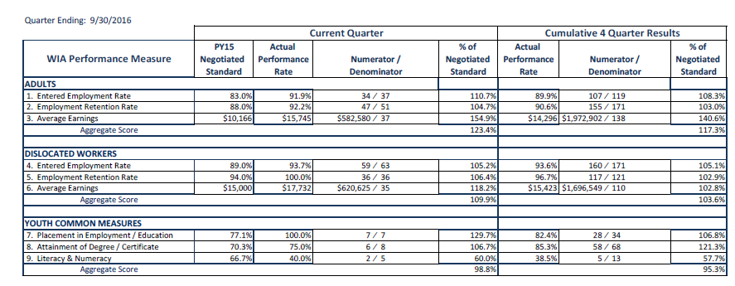
Administrative
Entity
Agenda Item
6I. Finance & Performance Review - Pages 25-26

Slide 10
Agency Contacts
Meeting Schedules, Communication, & Expense Reimbursement |  |  |  | Wendy Sieler, Staff Assistant Office of Employment & Training Nebraska Department of Labor (402) 471-2565 wendy.sieler@nebraska.gov
Board Planning & Support |  |  |  | Dylan Wren, Program Coordinator Office of Employment & Training Nebraska Department of Labor (402) 471-9878 dylan.wren@nebraska.gov
Program Oversight |  |  |  | Shannon Grotrian, Administrator Office of Employment & Training Nebraska Department of Labor (402) 471-9897 shannon.grotrian@nebraska.gov

Slide 11
Greater Nebraska Meetings

